Slide 1
Internship Studio Task 3

Slide 2
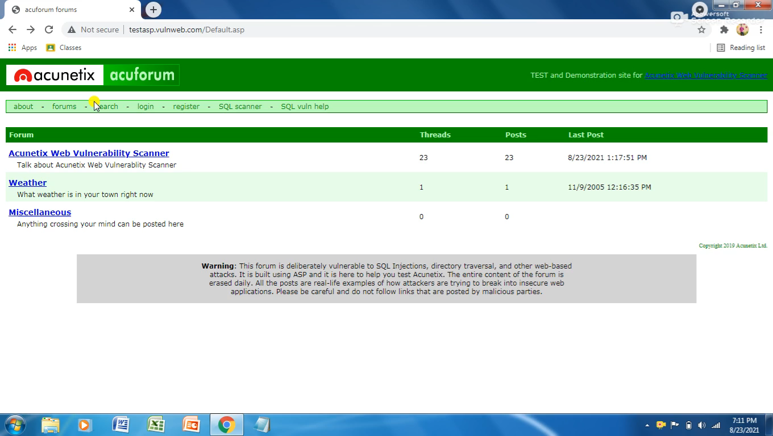
POC vedio

Slide 3
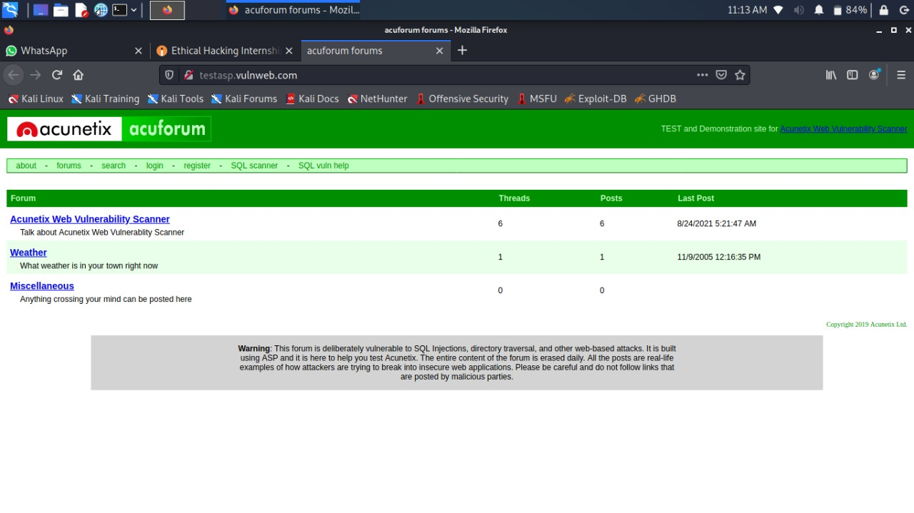
Screenshot of Task 3

Slide 4
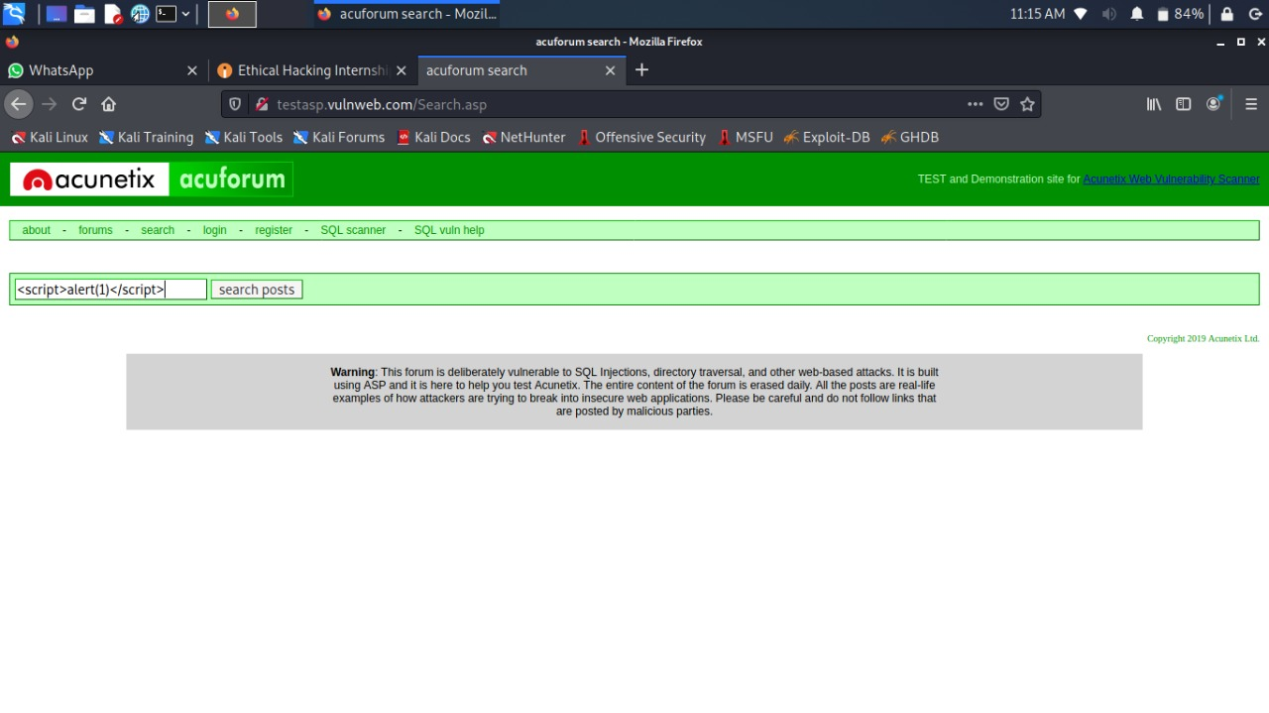

Slide 5
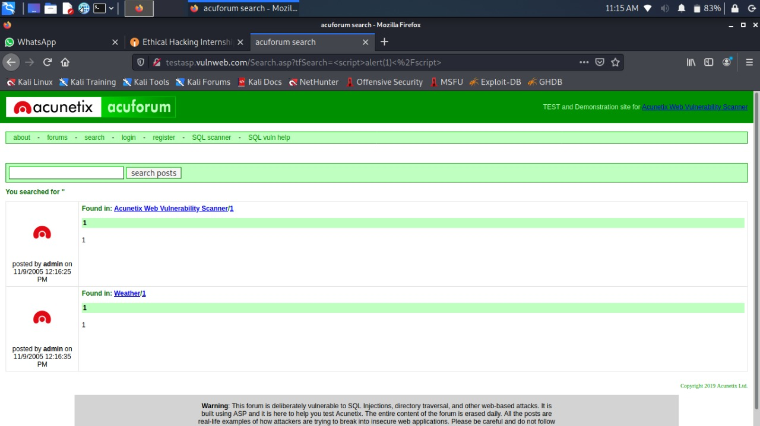

Slide 6
Task 3 report
Steps to reproduce:
Step 1: Visit http://testasp.vulnweb.com/
Step 2: On the top menu you will find a search option.
Step 3: Click on it and you will be prompted with the Search box.
Step 4: You can intercept the request in Burp Suite
Step 5: Now you can find different payloads for XSS.
Step 6: Send the request to the intruder and paste all the payloads.
Step 7: Try to find a successful payload for XSS.
Impact: It can be used to steal data of the users and it is very harmful to our costumer’s privacy.
Mitigation: If you want to prevent your website from such vulnerability then you can just enable noscripting on browser.
Poc including screen recording is included in the report which is attached below
Video.mp4

